Slide 1

BioSim TOOL STREAM project
Short guide to run the optimization and the simulations with BioSim Tool
Isabella Bitetto

Slide 2
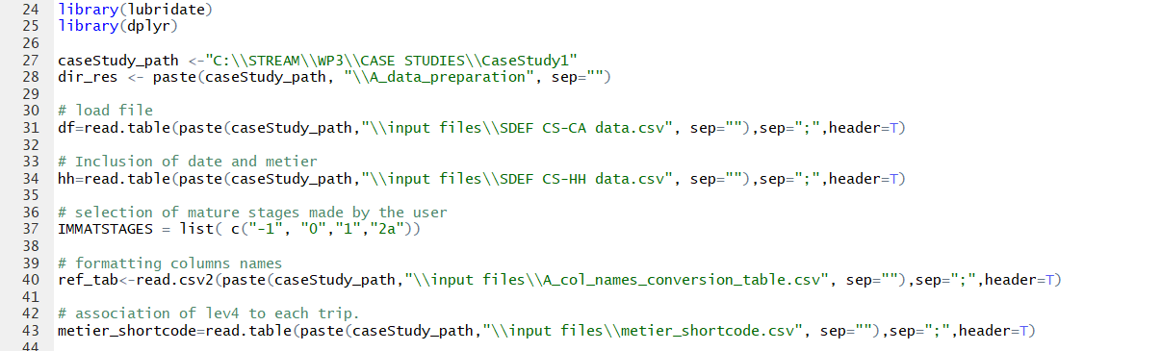
Data Preparation
caseStudy_path: the folder of the case study;
Df: CA table from SDEF format;
hh: HH table from SDEF format.
IMMATSTAGES: definition of the immature stages.

Slide 3
B_data_simulation_LENGTH
Settings: as before, except species name, short name, GSA; by_cat: if you put «Y», the samples will be defined as combinations trip-commercial category. If «N», only by the trip.
By_EUlev6/byEUlev4: put «Y» only on one of them; the other has to be «N». Used only for the summary of results; the resampling is not done according to this setting
By_quart: «Y» or «N». Used only for the summary of results; the resampling is not done according to this setting.
N_sims: number of simulations;
samp_sizes: the scenarios to be simulated (20 length measurements per trip, 30, 40 and so on…)
Then, run until line 151.
According to table produced at line 144 (summary(tab[,2])), set the min_n for the selection of the more representative samples.
Pay attention that min_n was higher or equal to the maximum in samp_sizes variable (scenarios to be simulated).

Slide 4
B2_calculate_subsample
Settings as before, except for:
thresholds_name: put the name of the file automatically created by the previous script catN_lev4_quartY where are stored all the scenarios (number of individuals by trip) with the correspong MWCV and EMD;
thresholds_table: a table indicating, for each level you chose for synthesizing the results in script B1, the sample size you prefer.
This script automatically estimates a posssible sub-sample to be eventually applied to the current sampling, respect to the optimal sample size you selected.

Slide 5
C_data_simulation_MATURITY
Settings: as before, except for:
Sex: «F» or «ALL»;
Then, run until line 174.
According to table produced at line 163 (summary(tab[,2])), set the min_n for the selection of the more representative samples.
Pay attention that min_n was higher or equal to the maximum in samp_sizes variable (scenarios to be simulated, number of individuals by trip for which to collect the maturity).

Slide 6
D_data_simulation_SEX-RATIO
Settings: as before.
Then, run until line 172.
According to table produced at line 161 (summary(tab[,2])), set the min_n for the selection of the more representative samples.
Pay attention that min_n was higher or equal to the maximum in samp_sizes variable (scenarios to be simulated, number of individuals by trip for which to collect the sex).

Slide 7
E_data_simulation_AGE
In this case the resampling is done not only at trip level, by also by length class (stratified)
samp_sizes: it is the number of otoliths to be collected by length class and by trip.
Settings as the previous scripts .
Then, run until line 173.
According to table produced at line 159 (tab), set the min_n for the selection of the more representative samples.
Pay attention that min_n was higher or equal to the maximum in samp_sizes variable (scenarios to be simulated, number of individuals by trip and length class for which to collect the age).

Slide 8
Remark
The scripts from A to E can be also used putting all the data together as a unique trip to in order to have the results of the CV on an annual basis instead of having as average number of data to be collected by trip (at trip level).
Pay attention only to correctly code the «artificial» trip consistently between CA and HH.

